Slide 1
Palos Verdes Peninsula High School
Athletic Booster Club
29th Annual
Athlete of the Year
Program
May 2020

Slide 3
Athletes, Coaches, Parents, Friends and Family!
Even though we were not able to hold the 29th annual Palos Verdes Peninsula High School Athlete of the Year Awards banquet this year, the Athletic Booster Club board decided it was still important to honor and acknowledge the accomplishments, leadership in sports, and athletic endeavors of the male and female nominees for the 2019-20 Athlete of the Year award.
The nominees for these awards are seniors, who have been selected by their respective head coaches. When more than one athlete per sport is deserving of this award because of his or her contribution on the playing field, the character and leadership of each candidate become the determining factors. Additionally, athletes at-large and special invites are those who are deemed so deserving of recognition by the entire pool of coaches, receive nominations from the coaches and Athletic Director. Following all nominations, varsity head coaches and the Athletic Director meet to hear presentations by the nominees’ respective coaches; a vote is then taken to determine the winner, or winners, of this very prestigious honor.
Two additional awards will be presented this evening. These are the Outstanding Captain of the Year and The Most Inspirational Athlete of the Year awards.
All the student athletes nominated have achieved exceptional performance levels in their respective sports through motivation, dedication, talent, self-discipline, and hard work. Their efforts are to be applauded. Their success is also the result of the direction and support they have received from their mentors, families, teammates, and coaches.
Congratulations to all our accomplished student athletes!
Bo Kelly and Mark Hama
Co-Presidents
Palos Verdes Peninsula High Athletic Booster Club
Portraits Courtesy of PSS Imaging

Slide 4
2019 - 2020
Athlete of the Year Nominees
Fall Athlete of the Year Nominee
Boys Cross Country Michael Takami
Girls Cross Country Paige Moore
Football Jack Haworth
Girls Golf Casey Syal
Girls Tennis Koko Makrygiannis
Girls Volleyball Katie Seaton
Boys Water Polo David Amano
Winter Athlete of the Year Nominee
Boys Basketball Luke Frasso
Girls Basketball Veronica Rojas
Boys Soccer Aidan Hay
Girls Soccer Kamea Vierra-Lambert
Surfing Colin Macleod
Girls Water Polo Catherine Nguyen
Wrestling Alex Britton
Spring Athlete of the Year Nominee
Baseball Kioto Shimamura
Boys Golf Jason Nowacki
Boys Lacrosse AJ Rosato
Girls Lacrosse Catherine Channell
Softball Kelly Beaupre
Boys Swimming Nicholas Sims
Girls Swimming Shae Smith
Boys Tennis Joshua Masuda
Boys Track & Field Aiden Lieb
Girls Track & Field No Nominee
Boys Volleyball Ryan Umbrell
All Year Athlete of the Year Nominee
Cheer Sarah McGuinness
Varsity Dance Lani Hollingsworth
Spirit Dana Goldstein
At-Large and Special Invite Athletes
At- Large| Alicia Carmona Cornejo | Girls Tennis
At- Large | Caleb Hall | Boys Basketball
Special Invite | Troy Simpkins | Boys Basketball & Lacrosse
At- Large | Clarke Godbold | Boys Volleyball
Special Invite | Jordan Quick | Girls Swimming
Special Invite | Ashley Wieland | Girls Cheer
Special Invite | Ricardo Punsalan | Football & Baseball

Slide 5
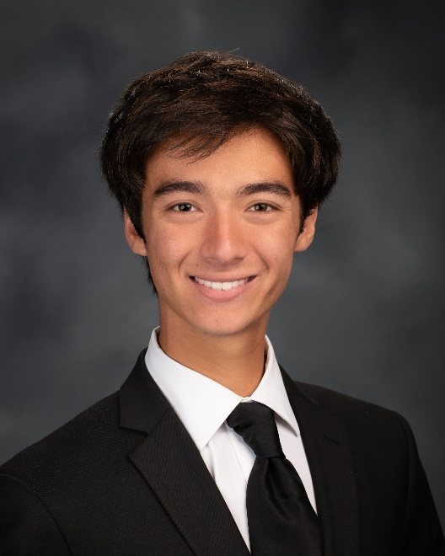
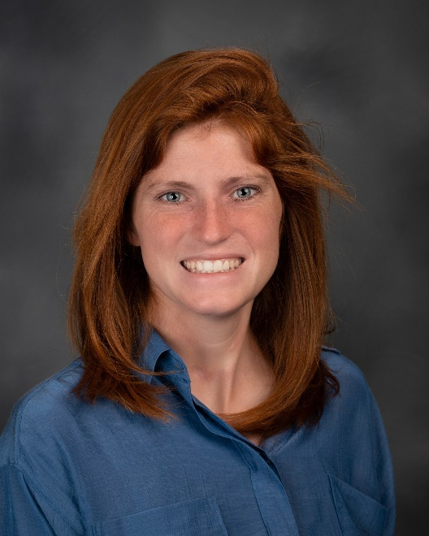
2019 - 2020
ATHLETE OF THE YEAR
Fall Team Nominees
Although, I’m not entirely sure where I’ll be attending next year I am currently committed to UC Santa Cruz to study computer science with a specialization in video game design. Cross country has easily been the best activity of high school and the memories of races and long practices with miles upon miles will be with me for the rest of my life. I’d also like to thank all the coaches who have helped me along the way but especially Coach Foster, Coach Nishimi, Coach Dill, and Coach Slattery. The coaching staff not only helped me get to the athletic level I never could’ve dreamed of, but also made me mentally strong enough and taught me valuable lessons and a work ethic that I try to bring to any venture I embark upon, athletic or not. And of course, my parents and friends who have always pushed me along the way and screamed my name as I ran across the field. Easily my best memory from this past season was being able to represent Peninsula in the varsity stripes at CIF Prelims and later CIF Southern section finals, something that hadn’t been accomplished in quite a long time. Again, I’d like to thank Peninsula for all the opportunities and memories they have given me athletically. More love and more life!!!
Michael Takami
Boys Cross Country
Next year I’ll be attending Cal Poly Pomona and plan to join the running club. I have loved this team since the first day of practice my freshman year. Peninsula Cross Country has given me so much, namely, good friends, outstanding role models, and wonderful memories, and it has taught me so much, too. I’ve learned to be patient which is important because athletes need to work hard before achieving their goals. I’ve learned to be respectful and supportive of my teammates because they are working hard too. I’ve learned to have fun even when I’m having a bad race because everybody has bad races. Participating on a cross country team is not easy; in fact, it's quite challenging, but that’s what makes it great! The best part of the cross country season is not any particular race or meet but instead the daily process of working with my coaches, making steady improvement, and running alongside good friends. I would like to thank Coaches Foster, Slattery, and Nishimi and my awesome teammates for all they’ve done for me these past four years, and my family for their support and love.
Paige Moore
Girls Cross Country

Slide 6
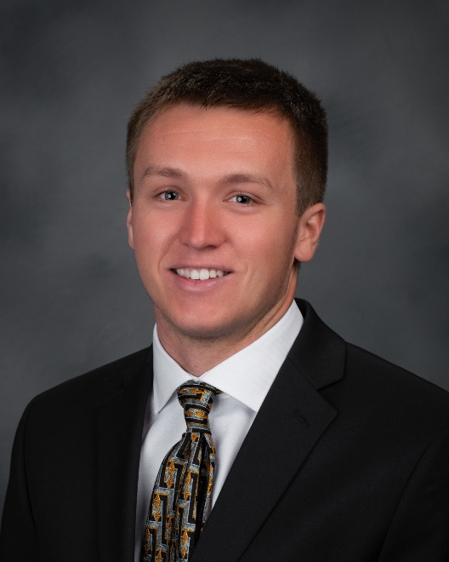
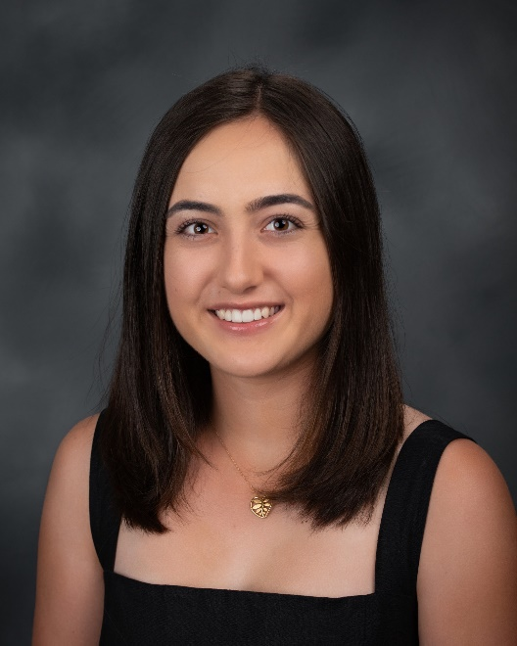
2019 - 2020
ATHLETE OF THE YEAR
Fall Team Nominees
I will be attending Gonzaga University. After one of the toughest decisions of my life, I decided that I will not be continuing my athletic career at the collegiate level. I am so grateful for all the memories I have made playing both football and baseball at Peninsula. I have learned such incredible life lessons that I will take with me for the rest of my life. I have especially learned how to overcome adversity and how to work hard at something you love. It is important to never let anything bring you down and to keep fighting for your goals. I will never forget the post-game locker room celebrations after a big victory. “Mo Bamba” was always a go-to celebration song. I would like to thank my entire family for all of their support throughout my entire life with sports. Thank you mom, my grandparents, my two sisters, and both my uncles for supporting me with everything. Without your support, I don’t know what I would have done. Thank you to Coach Young, Coach Campbell, Coach Bowles, Coach Nicholson and to all of the other coaches who have supported me. And lastly, I want to give a special thanks to Scott and Marissa for being the best and most kind athletic trainers ever. I will sincerely miss Pen. #pantherforever
Jack Haworth
Football
My favorite memory was winning Bay League as an individual my senior year, as well as playing in CIF individuals with my friends from all around SoCal. Next year I will be attending Duke University. I currently am not playing golf there, but in the future, I might walk on. Playing sports at Peninsula was one of the best memories of my high school experience! It taught me time management and perseverance, and also provided me with a team experience in what had been an individual sport my whole life. I would like to thank my parents for all of the long drives and for always believing in me, as well as Coach Van Enk for his constant positivity and for putting up with me for four years. And lastly, my teammates for some of the most fun times I've had on the golf course.
Casey Syal
Girls Golf

Slide 7
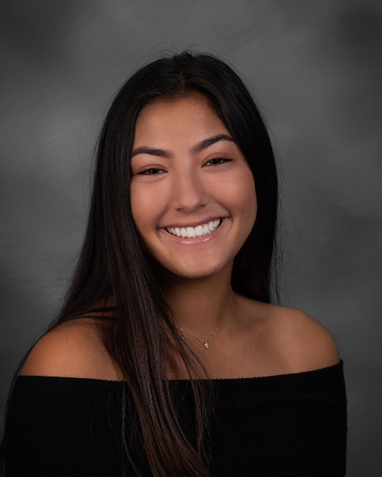
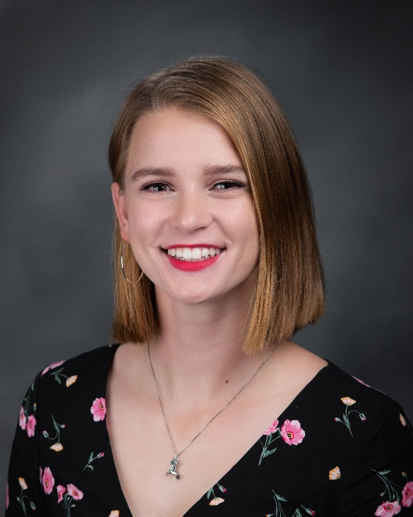
2019 - 2020
ATHLETE OF THE YEAR
Fall Team Nominees
In the Fall, I will be attending the University of Michigan. I look forward to playing on their club tennis team and helping them win another national championship! My four years on the Varsity Tennis team were the highlight of my Peninsula High experience. The competition and comradery made for an incredible high school journey. One of my best memories took place this past season. We won the Open Division of CIF, and my doubles partner and I made it to the finals of CIF individuals and the Semifinals of State! It was something I had been striving for since I was a freshman, so to finally win CIF and advance as far as we did in State was a truly rewarding experience. I would like to thank my parents, my coaches Kip Brady and Mike Hoeger, and most importantly my teammates for allowing me to love tennis even more than I thought imaginable.
Koko Makrygiannis
Girls Tennis
I am excited to be attending California State University Chico next year, but I have no current plans to continue competing at a collegiate level. In the previous four years, Peninsula Volleyball has given me the opportunity to grow as both a player and a leader thanks to my amazing teammates and coaches. I am forever thankful to the coaches and trainers who've helped me to succeed and recover through the years. I am also thankful for my parents and friends for their support at every match.
Katie Seaton
Girls Volleyball

Slide 8
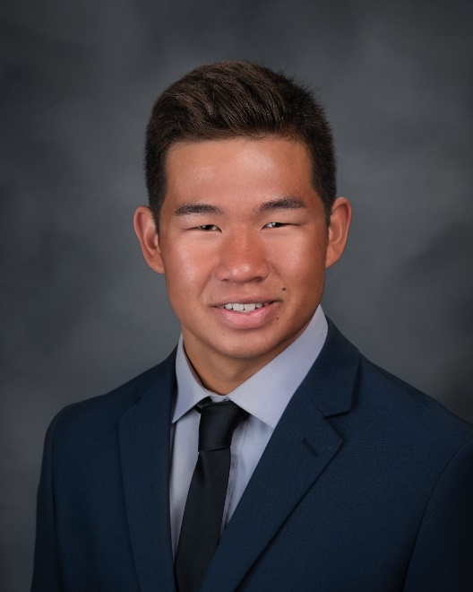
2019 - 2020
ATHLETE OF THE YEAR
Fall Team Nominees
I will be attending the University of San Diego on a NROTC scholarship and I will be playing club water polo. During my time at Peninsula I met many of my good friends through the team and we went through some tough seasons together. While playing for Peninsula I learned the importance of teamwork in competition. This camaraderie is what lead to my pursuit of military service. One of my favorite memories is playing hard and coming back during a tournament game this past season. This victory brought us together as a team. I would like to thank my parents for coming to my games and Coach Kaye for always working with and supporting me.
David Amano
Boys Water Polo

Slide 9
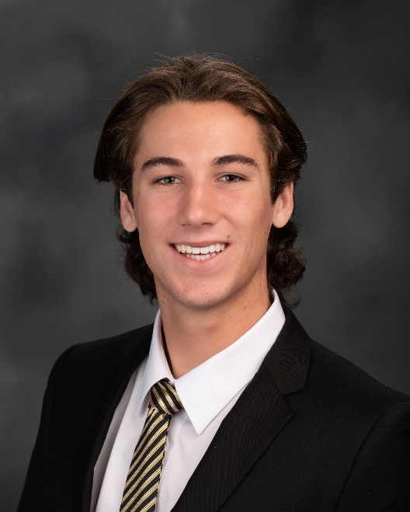
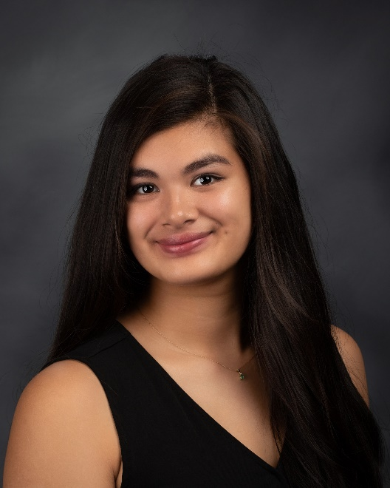
2019 - 2020
ATHLETE OF THE YEAR
Winter Team Nominees
I will be attending LMU – Loyola Marymount University in the fall. My Peninsula Basketball years were an exciting and fun experience. They were some of the best years in high school. Basketball taught me that hard work and discipline helped me excel to the next level for the game that I truly love to play. One fun memory I have was getting a dunk on our home court against our rival team – PV High! I would like to thank Wendell Yoshida for his countless hours watching our basketball games, Coach Quinlan for his countless hours of coaching me and making me a better player and person, Coach Acres for being my first High School coach and developing me into a better player, and Coach Mirsky for me to see my potential and pushing me to be the best I can be. I want to thank trainers Scott and Marissa for always putting us back together. I want to thank my Family, first off. I’d like to thank my Dad for all his years of coaching me in basketball and other sports as well, my Mom for all the years of washing sweaty uniforms, making sure I’m well fed and for being at every game no matter where it was, oldest brother Jake, for encouraging me and teaching me to get air and slam dunk, and my middle brother, Nick, for always playing me in a competitive game of basketball in our driveway.
Luke Frasso
Boys Basketball
Next year I will be going to El Camino and I won't be playing basketball. Playing basketball at Peninsula has taught me many things like communication, working with others and time management. During this last season there were so many fun memories, but one of my favorites was our trip to San Diego. We had so much fun traveling and spending time together. There are so many people who have helped me succeed. Thank you Mom and Dad for taking me to all the games and practices. Thank you Coaches Harvey Kitani and 80/20 coaches, Scott Yamada, Scott Tojo, Ryan Hamada, Jared Lloyd, Pat Sakasegawa, Theo Hawkins and the coaches who have helped me along the way.
Veronica Rojas
Girls Basketball

Slide 10
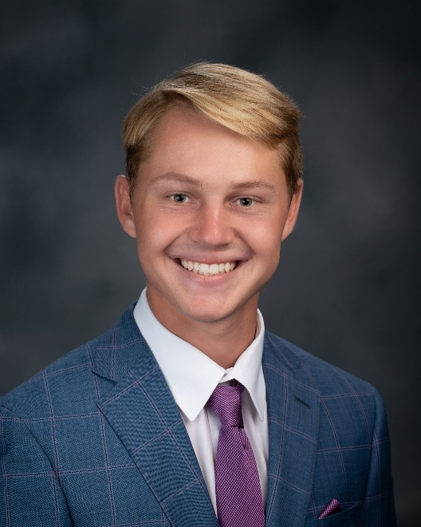
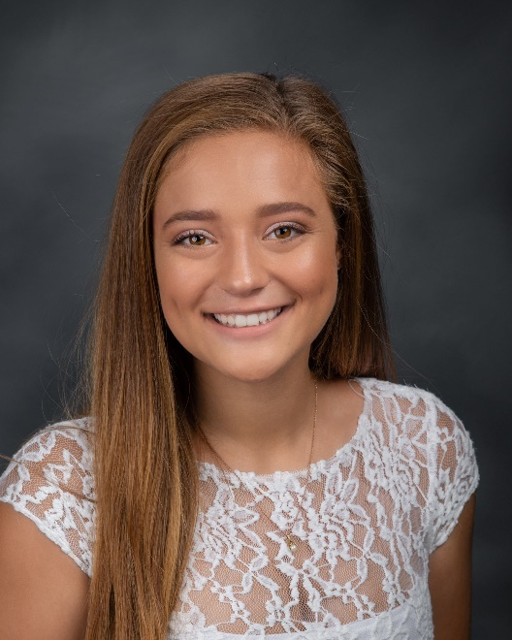
2019 - 2020
ATHLETE OF THE YEAR
Winter Team Nominees
One of the best parts about attending Peninsula High School was the opportunity to play soccer, volleyball and tennis. I learned a lot about the sports I played, how to be a leader, and how to play different roles on a team. Being an athlete at Peninsula helped build my love of sports. A couple of my favorite memories were scoring the winning goal at the Championship game at the Monrovia soccer tournament my senior year and winning CIF in Volleyball my junior year. I’m excited to say that I will be continuing my education and playing Division 1 soccer at California Baptist University. I would like to thank my parents for their unwavering support, my sisters for being role models as student athletes, my friends and teammates for making it fun and always having my back and for Coach Daley, Coach Francisco, Coach Kevin, Coach Barcenilla and Coach DeWitt for not only teaching me about the sport but about life and how to be a better person. Thank you to the ABC Board for making this Athlete of the Year event special during such a crazy time.
Aidan Hay
Boys Soccer
In the fall, I will be attending Grand Canyon University in Phoenix, Arizona, where I will be studying Nursing. Coming into high school I knew I loved soccer, and everyone else knew I did too. When I tried out for Peninsula’s team I had no idea of the large impact this program would have on my life. My amazing coaches saw something in me that I didn’t and put me on the varsity team as a freshman. What an amazing honor! As my time on the varsity team passed my junior year came along and I was named co-captain of the team. I didn’t know if I was ready for that role, but my coaches and teammates had faith in me and I learned to have faith in myself. I learned to have a new sense of confidence, how to be a productive leader, the real power of connections, and most importantly, that love makes a family not blood. Every single girl that I have gotten the privilege of playing with is one of my sisters, and I am forever grateful for the lessons they have taught me. My favorite memory from my four years of playing on this team would have to be blasting music on the bus rides and making up fun dances to every song that came on. This team wouldn’t be a team without my girls so a huge thank you goes out to them for all of the good times, not so good times when we had each other’s back, and for making this school feel more like home. Thank you to my amazing coaches who encouraged me and pushed me to be my best self, and gave me a purpose when I didn’t feel like I had one. Lastly, thank you to my mom. When my dad passed away I wanted to quit soccer because I couldn’t imagine myself playing without him in the stands, so I want to thank her for always being my biggest cheerleader and pushing me to follow my dreams. Through the hours of practice, many games, too much time spent in the trainer’s room, and the countless laughs that this program has given me I stand before you as the person I am today, a proud panther who will be forever grateful for the girls varsity soccer team.
Kamea Vierra-Lambert
Girls Soccer

Slide 11
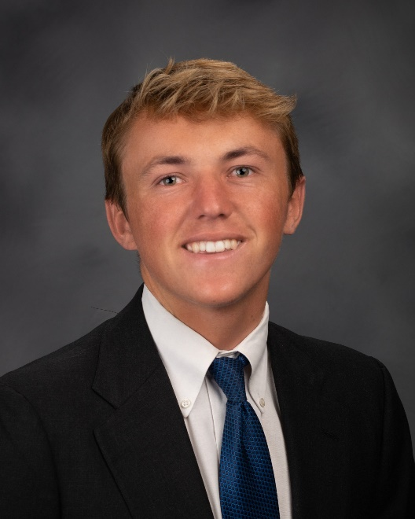
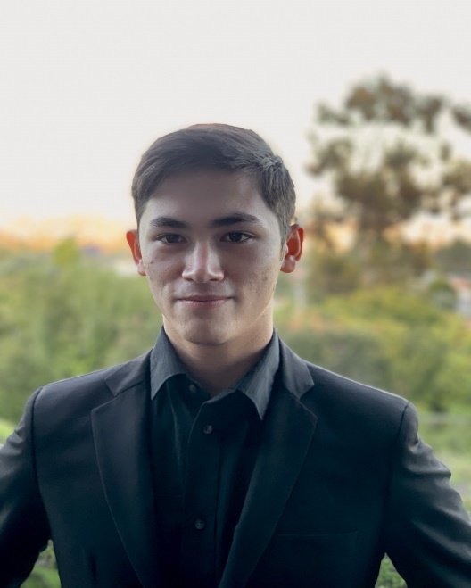
2019 - 2020
ATHLETE OF THE YEAR
Winter Team Nominees
I will be attending San Diego State University in the fall where I will continue to surf on their team. I have had an incredible time on the surf team at Peninsula. I met some of my best friends through this team and my surfing ability improved greatly. One of my fondest memories from the surf team is one day in the middle of winter when the waves were really good. We all surfed that morning and had the best time ever so we decided that we would all go to a spot called the cove to surf again after school. I got there and most of the team was already out so I paddled out as fast as I could. We all surfed until the sun set and it was one of the best surf sessions I’ve ever had. Overall the Peninsula surf team has been a perfect place for me to grow and make friends. I’d like to thank my dad first of all because he is the one who got me into surfing and helped me all along the way. I’d also like to thank coach Helmrich for improving my surfing and always giving me good advice. Finally, I’d like to thank everyone on the surf team for always being so supportive and fun. They are the best teammates I could have ever asked for.
Colin Macleod
Surfing
I will be attending the Electrical Engineering program at the University of Arizona. I would like to continue Wrestling if I can balance my college life. My favorite memory was being able to be part of the team and treated like family, no matter the circumstances. Through Wrestling, I learned to work hard, always find an opportunity to improve, keep trying, and to strive for the best. I was struggling to adjust to a new school and senior year. My teachers, coaches, and my family were by my side teaching and supporting me all along. I couldn’t have done it without you. Thanks so much!
Alex Britton
Wrestling

Slide 12
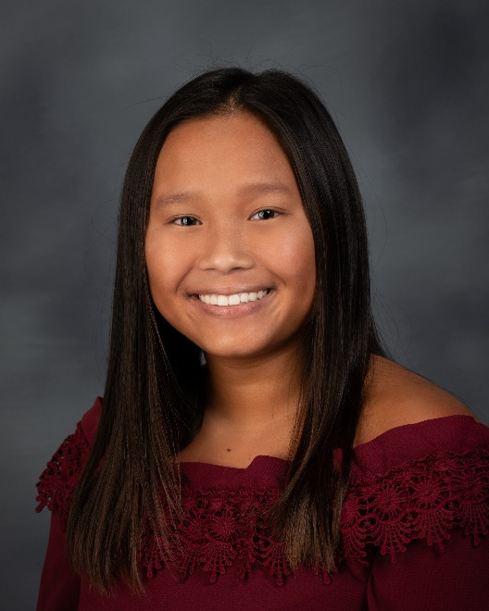
2019 - 2020
ATHLETE OF THE YEAR
Winter Team Nominees
I will be attending University of California, Santa Barbara next year. I won't play on the school team, but I'll probably play club or join an intramural team. I played on the varsity water polo team for four years and swim for two. They have been some of the best parts of my time at Peninsula. I've learned hard work, teamwork, and met some of my best friends in sports. My favorite memory this season was making CIF division playoffs for the first time in 3 years. I'd like to thank all of those who've supported me for the past 4 years - my parents and siblings, coaches, and friends.
Catherine Nguyen
Girls Water Polo

Slide 13
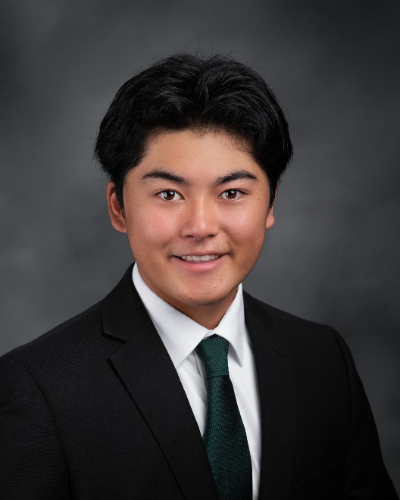
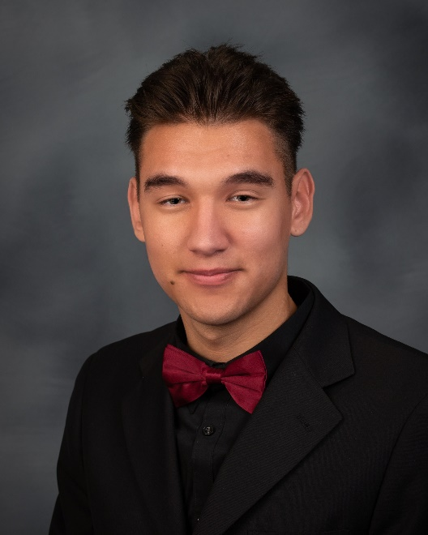
2019 - 2020
ATHLETE OF THE YEAR
Spring Team Nominees
This fall, I will continue my academic endeavor at the University of California Santa Barbara. Playing baseball at Peninsula has taught me the importance of perseverance and unity. The long off seasons in the fall and winter forced our team to grow closer, and served as prime grounds for friendly competition. As my coach used to say, “High tide raises all boats”, and those few months brought out the best in us. Although many of my fondest memories of baseball were on the field, my favorite time would have to be the bus rides back after a big win. That postgame mixture of exhaustion and joy was my form of pure happiness. I would like to thank all of my selfless coaches who put the program before themselves, and the countless hours they spent dealing with my stubborn self. I would also like to thank my parents who sacrificed their time and energy to give me the chance to pursue the sport that I love. Finally, I would like to thank all of my teammates and opponents who pushed and challenged me to reach the best version of myself.
Kioto Shimamura
Baseball
Hi everyone? Just wanted to say thank you to everyone that has helped me get here. I'd like to thank my Dad for introducing me to the game of golf and I'd like to thank Coach Van Enk for being an amazing coach all four years that I was there. Next year I will be going to El Camino College studying business administration and I will not be playing golf there. One fun memory that I would like to share is going to 7-eleven after a match that we won, and we got Slurpees.
Jason Nowacki
Boys Golf

Slide 14
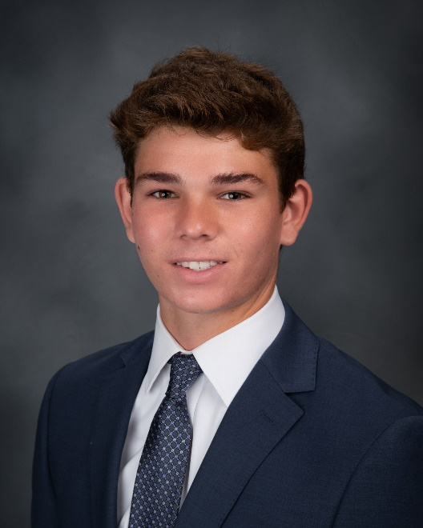
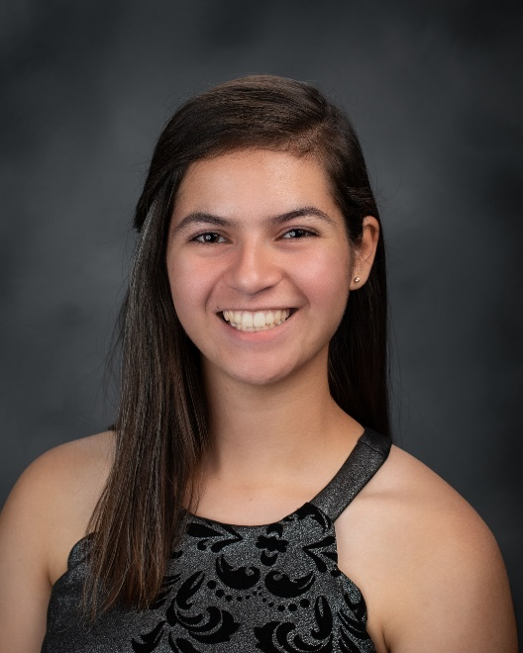
2019 - 2020
ATHLETE OF THE YEAR
Spring Team Nominees
This fall I will be attending the University of Colorado Boulder and trying out for the lacrosse team. My 4 years playing sports at Peninsula have been full of joyful wins and frustrating losses that will last in my memories forever. As a freshman I made the Varsity lacrosse team where I played against guys that were a foot taller and 50 lbs heavier than me. My favorite memory from this season was the first game. I had a pretty nasty stomach virus which made me sick 4 times during the game, but I was able to clutch the game winner in the last minute of overtime. I would like to thank the trainers for helping me get back onto the field after too many injuries, my coaches for giving me so much knowledge that I can take to the field and life, my parents for having endless support in everything I do whether that be sports, schooling, or my social life. And to my 2016 Huarache cleats that just keep digging with me through tournaments and seasons from sophomore year to now.
AJ Rosato
Boys Lacrosse
First of all, I would like to start this off by thanking my incredible coach, Mrs. Borstel, my parents, and all of my teammates for their guidance, support, and enthusiasm over the past four years. I will be attending Loyola Marymount University as a Trustee Scholar this fall where I hope to continue to play lacrosse as an intramural sport. Playing on Peninsula’s lacrosse team has been an integral part of my high school experience. In addition to lacrosse, I’ve played soccer for Peninsula and can say that the community present on both teams is something not found in the classroom nor library, but a teamwork forged of common challenges and funny inside-jokes. I had the uniquely wonderful opportunity to be our glax goalie last year for the last of our league games after our full-time goalie received a concussion. The sheer terror and adrenaline of being shot on in goal and the moments of laughter that followed have made it my favorite memory of the team. It represented a time when I stepped out of my comfort zone and everyone else worked extra hard to help teach me, help each other out, and, of course, have a lot of fun. Coming away with bruises that spotted my legs like a dalmatian, it gave me a new perspective of my team’s ability and effort. I will miss it so much. Thank you again for everyone that has been part of my years here, I appreciate it more than words can express. Go Panthers!
Catherine Channell
Girls Lacrosse

Slide 15
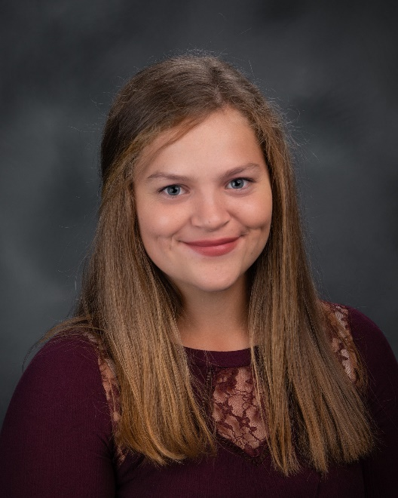
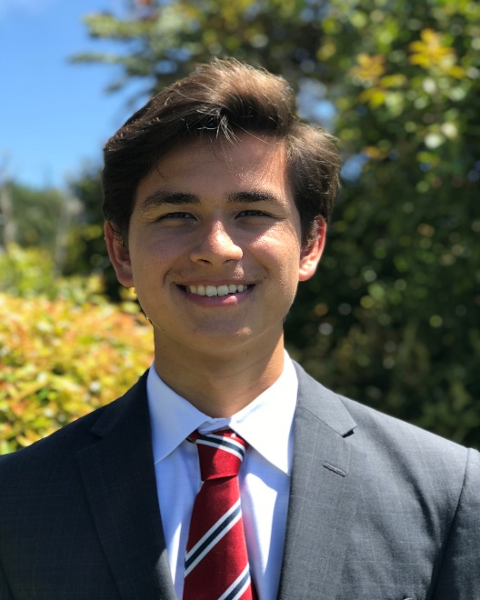
2019 - 2020
ATHLETE OF THE YEAR
Spring Team Nominees
I will be attending Dartmouth College next year to play Division 1 softball. Playing varsity sports at Peninsula for four years has given me an outlet for my passions, and teams that have become my family. I am grateful to have had mentors and friends in my teammates, and the ability to grow as a leader through my sports. Although season was cut short, I appreciate the memories we had on the field as a team. My favorite memories from this season were getting hyped up before games in warm up, listening to our eclectic playlist, and jumping into the on-deck circle for our pre-game cheer. I am thankful for my parents and coaches and their constant support. Also, I am grateful for the trainers' help, which was invaluable the last two years.
Kelly Beaupre
Softball
I am planning to attend the University of California, Berkeley in the fall and participate in both club swimming and water polo. My experience playing sports at Peninsula was incredibly positive and I will cherish these memories for life. Through sports, I met some of my best friends and learned some important lessons such as channeling nervous energy into success, communicating with a team, and manage academics and free time. One especially poignant memory of my Peninsula sports experience was during the 2018 Bay League Finals when I dropped 5 seconds in my best event and achieved first place in the final heat. These achievements, however, would not be possible without those who mentored and guided me. I'd like to thank Swim Coaches Helmrich and Shari and Water Polo Coaches Kaye and Charles for their knowledge and love for the sport. Finally, I'd like to thank my loving parents for their support while I pursued athletics during my years at Peninsula.
Nicholas Sims
Boys Swimming
Shae Smith
Girls Swimming

Slide 16
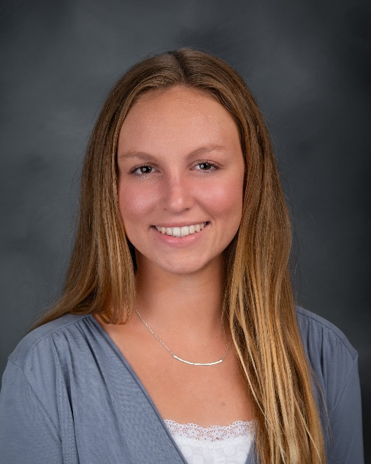
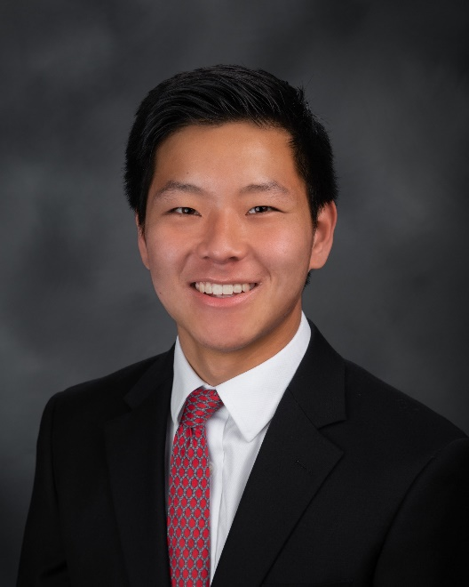
2019 - 2020
ATHLETE OF THE YEAR
Spring Team Nominees
I am beyond excited to continue my swimming and academic career at Chapman University in the fall. I know that I would not be where I am today without the guidance and support of my parents and coaches. I would especially like to thank Coach Shari and Coach Helmrich for all the fun meets and team activities as well as for constantly pushing me to strive for my best. Being a varsity student-athlete at Peninsula has taught me the importance of teamwork, time management, and leadership. I know that competing for Peninsula has changed my life for the better and I will bring my experience to college in the fall as I continue my swim career.
Shae Smith
Girls Swimming
I will be attending the Massachusetts Institute of Technology (MIT) in the upcoming fall and will be a member of the MIT men’s tennis team. I am extraordinarily grateful for my experiences at Peninsula High given the rigorous academic options and excellent athletic opportunities that enabled me to pursue my ambitions at the collegiate level. The camaraderie of the tennis team and reaching the CIF Division 1 state championship was one of my most memorable highlights in high school. I am so thankful to Coach Hoeger and my teammates who helped shape my character and were an important part of my amazing high school experience. The memories and the lessons I learned from Peninsula will forever be a part of me!
Joshua Masuda
Boys Tennis

Slide 17
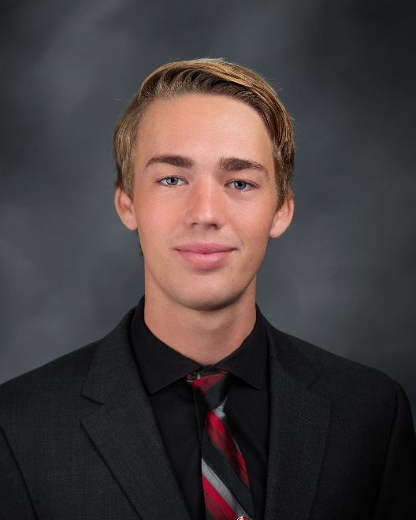
2019 - 2020
ATHLETE OF THE YEAR
Spring Team Nominees
I will be running for the University of California Los Angeles next year. Running at Peninsula is a time I will never forget. Every single person on the track team has a distinct personality. There was never a dull moment at practice. My favorite memory during my time at Peninsula was Bay League Championship my Junior year. I would like to thank my 2 private coaches Marieke Miller and Kelvin Gamble, my mom, and my 2 best friends Jake Williams and Josh Ling for supporting me throughout my years at Peninsula.
Aiden Lieb
Boys Track & Field
No
Nominee
No Nominee
Girls Track & Field

Slide 18
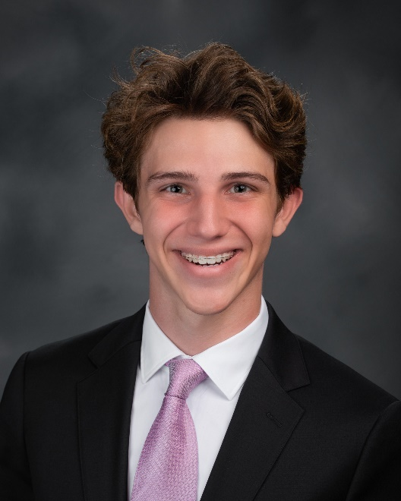
2019 - 2020
ATHLETE OF THE YEAR
Spring Team Nominees
I will be attending Southern Methodist University – Cox School of Business, I will not be playing any sports there. I met a lot of good friends through the program. My best memory during the season was getting the CIF ring from Coach. I would like to thank my supportive parents and Coach Kevin.
Ryan Umbrell
Boys Volleyball

Slide 19
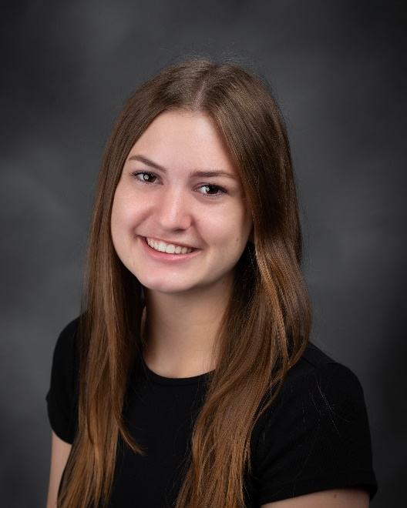
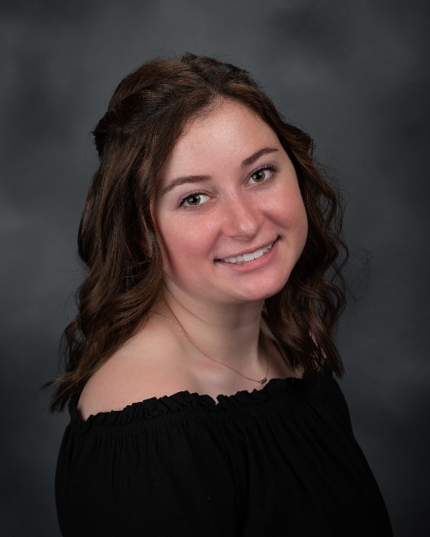
2019 - 2020
ATHLETE OF THE YEAR
All Year Team Nominees
I will be attending The University of Kansas in the Fall. Over the past four years I have met so many people through cheer that I have grown very close to. In addition to meeting great people, I've been taught a whole new level of responsibility and teamwork. My favorite memory from this past year was the Remember the Titans night game at Pen. The stands were packed to the brim and the energy was crazy. It was a fun crowd to perform for, a good game and a great night. I would like to thank my parents for their endless support coming to countless games and competitions. I’d also like to thank my coach, Kim Stoneman for all of the hard work and long hours she's put into the team. Lastly, I want to thank the zoo for always showing up and having a good time.
Sarah McGuinness
Cheer
I will be attending the University of California Davis next year. My time on song at Peninsula made me into the dancer and spirited student I am today. I’ll never forget doing the zoo groove every game and performing in front of all my friends. Thank you to my teammates, parents, coaches, and everyone else that’s been around these past four years. It’s been a good ride.
Dana Goldstein
Spirit

Slide 20
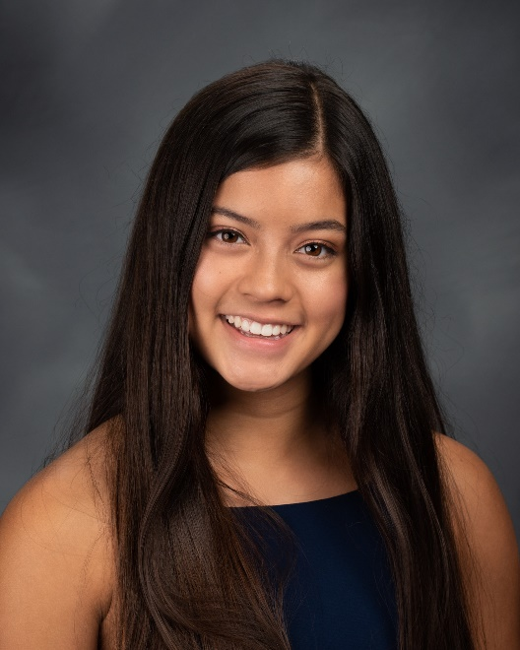
2019 - 2020
ATHLETE OF THE YEAR
All Year Team Nominees
I will be attending UC Berkeley in the fall, and I will be joining a dance company at the school. My 4 years on the Varsity Dance team at Peninsula has changed me forever. It has taught me the power of teamwork, perseverance in the face of numerous obstacles, and most of all, enjoying the hard work I put into every practice. One of my fondest memories from dance at Peninsula is when we went to finals at our dance Nationals with one of my favorite dances ever, Let It Be. We were so ecstatic, and we poured our hearts out on the dance floor, a feeling I will never forget. Thank you to Ms. Hendrick, who has been the most inspiring coach these years, to all the parents who always showed us love and support, and to ABC for their generous contributions to the dance program.
Lani Hollingsworth
Varsity Dance

Slide 21
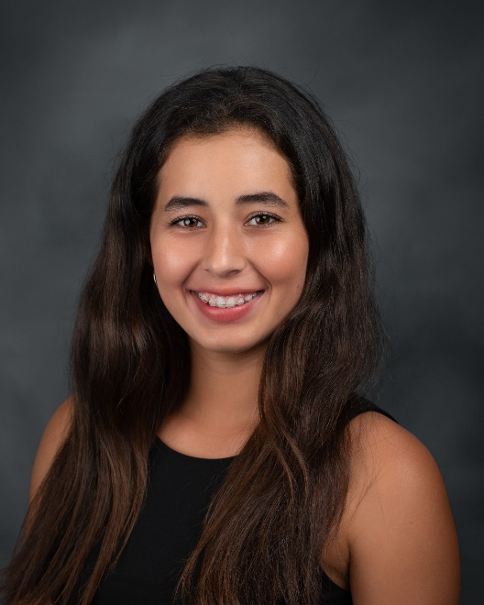
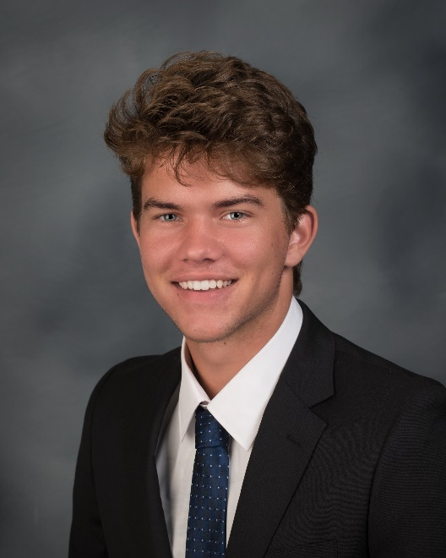
2019 - 2020
At-Large & Special Invite
I will be attending Pomona College in the fall and will be playing on the Pomona-Pitzer Women's tennis team. Playing four years of varsity at Peninsula has been such a great experience and I will always cherish it. Being part of the team meant being in a wonderful family who always supported me. My favorite memory was winning my three matches in CIF semi-finals and allowing my team to make it to the finals where we ended up winning the championship. I would like to thank all my coaches and parents for giving me these opportunities to succeed in tennis. I would especially like to thank my teammates for making my four years of high school tennis so memorable.
Alicia Carmona Cornejo
Girls Tennis
AT-LARGE INVITE
My time playing basketball at Peninsula has been a special four years, competing on the court with people who quickly became some of my closest friends. I want to thank my family for the support they provided, the coaches for their continual guidance and dedication to me and the program, and my teammates for the special moments we spent together playing as hard as we could in front of the ZOO...especially the moments playing our rival PV, which were games I will remember for the rest of my life. I have never experienced camaraderie quite like the teams I've played for at Peninsula, and for that I thank them. Next year, I will be attending Cal Poly SLO as an engineering major and intend to try out for the team as a walk-on.
Caleb Hall
Boys Basketball
AT-LARGE INVITE

Slide 22
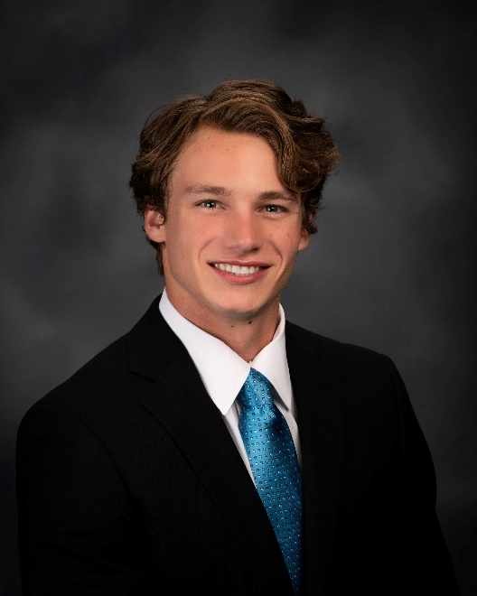
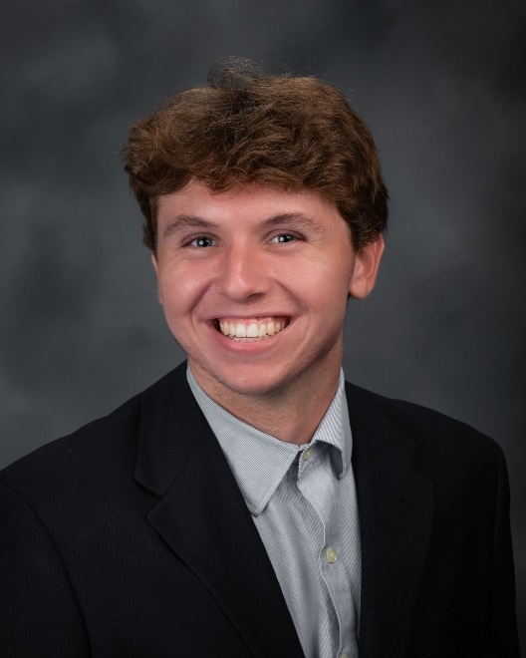
2019 - 2020
At-Large & Special Invite
Next year I will be attending the University of Southern California to study business. I hope to continue staying active by playing intramural or club sports. Playing sports at Peninsula has taught me what it is like to belong to a family outside of home. It has provided a platform for me to form relationships with some of my best friends. One of the highlights of my high school career was traveling to Orlando, Florida for a basketball tournament. The tournament was fun, but it was the time off the court that I'll never forget. Trips like that are what make me love my teammates. Finally, I would like to thank everyone who has helped me along the way. My parents are my number one supporters and the reason I have achieved such success. I also want to thank my coaches for not only being my coaches, but my mentors and friends. If it weren't for the trainers, I wouldn't have made it as far as I did. As a fairly injury-prone person, I was always in need of the trainers and they always accepted me with open arms.
Troy Simpkins
Boys Basketball & Lacrosse
SPECIAL INVITE
I will be going to Long Beach State and playing volleyball. My best memory is when we played in the semi-finals of the State Championships and it was a home game in front of the packed ZOO. We played against South my freshman year and got destroyed and I was so embarrassed. It changed my mindset and made me work hard, so that would never happen again. I'd like to thank my family, Coach B and Coach Kevin for sticking with me through highs and lows. I'd also like to thank Scott, the trainer, for always letting me come in early for treatment. I also want to thank all my teammates for all the laughs and making it a fun time on the court.
Clarke Godbold
Boys Volleyball
AT-LARGE INVITE

Slide 23
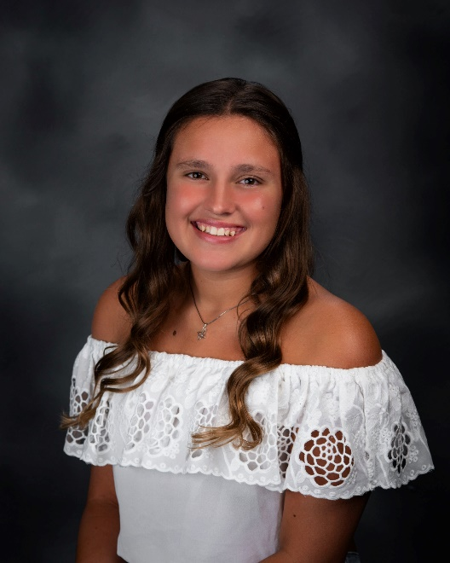
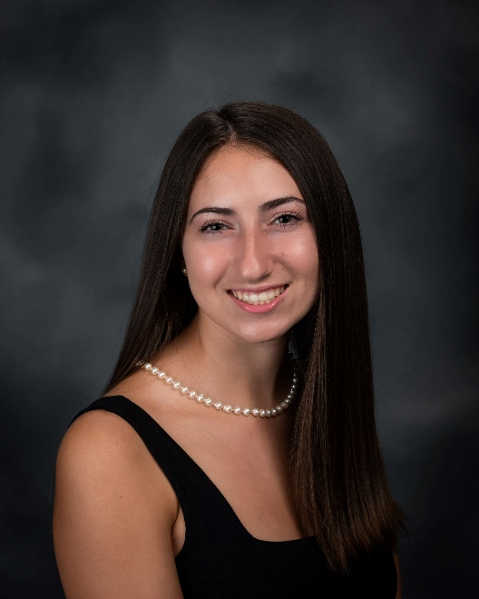
2019 - 2020
At-Large & Special Invite
I will be attending the University of Hawaii at Manoa in the honors college and will be swimming as a part of their masters program. Swimming for Pen has been one of the best parts of my high school experience and has taught me so much about the importance of good leadership, showing up for your teammates, and how every second counts. My favorite memory is from Bay League Prelims when one of my teammates got a hairbrush stuck in her hair and it took almost 40 minutes to get out. It was truly a team effort to get out and was the bonding we needed going into Bay League finals. I’d like to thank my parents, coaches, teammates for all the support and everything they’ve done for me these past 4 years.
Jordan Quick
Girls Swimming
SPECIAL INVITE
I will be attending El Camino College, studying psychology with plans to transfer to a 4-year university. Having the opportunity to be a part of the Peninsula Cheer team for 4 years has been amazing. Coach Kim has been a huge part of this. We have worked hard, had lots of fun, and have given back to our community. Being a part of this team has helped make me a well-rounded person and has given me leadership experience. I will always cherish my time at Peninsula and the time with my cheer sisters. One of my best memories of this year was the night football game. Cheer hosted our junior Panthers, Peninsula Football had their first HOME night game in over 15 years, the stands were overflowing for the Remember the Titans game, and we won! Thank you so much to Coach Kim, the Peninsula administration, my cheer team, my co-captains Sarah and Ana, classmates and friends, my parents, brothers, and extended family. You have all touched my life and made me the young woman I am today.
Ashley Wieland
Cheer
SPECIAL INVITE

Slide 24
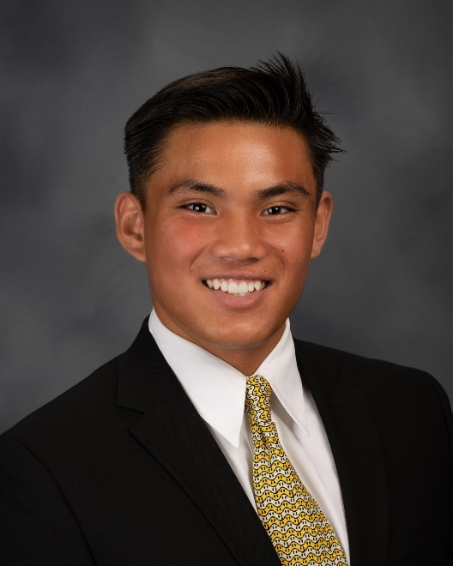
2019 - 2020
At-Large & Special Invite
Firstly, I’d like to say that I am extremely grateful to have received this nomination and blessed with yet another opportunity to represent Peninsula athletics. When I stepped on the field two years ago as an official panther, it felt less like a transfer and more like a reunion, and I didn’t realize how much I missed the brothers that I grew up with. It didn’t take long for me to feel like a true son of Peninsula High School. My most memorable experience was playing football under the lights. It was great making history with the team and on a personal note, it was my first game back. Most importantly, I had family in the stands and on the field. There aren’t enough words to express how thankful I am of my coaches, trainers, doctors, and parents. Thanks to all of you as I continue my athletic career playing football and running track at Willamette University. Go Panthers!
Ricardo Punsalan
Football & Baseball
SPECIAL INVITE

Slide 25
2019-2020
Varsity Teams
Post Season Results
Fall Post Season Results
Boys Cross Country 3rd in League – CIF Individual
Girls Cross Country 4th in League – CIF Team;State Individuals
Football 4th in League – CIF 1st Round
Girls Golf 2nd in League – CIF Team; Indiv. 1st Round
Girls Volleyball 4th in League
Boys Water Polo 4th in League
Girls Tennis League Champion;
CIF Open Division Champion;
CIF State Southern Regional
Winter Post Season Results
Boys Basketball 3rd in League – CIF Quarterfinal
Girls Basketball League Champion – CIF Semifinal;
CIF State Southern Regional Semifinal
Boys Soccer 5th in League
Girls Soccer 4th in League
Surfing
Girls Water Polo 4th in League – CIF 1st Round
Wrestling 5th in League – CIF Individuals
Spring Post Season Results
Baseball
Boys Golf
Boys Lacrosse
Girls Lacrosse
Softball
Boys Swimming
Girls Swimming
Boys Tennis
Boys Track & Field
Girls Track & Field
Boys Volleyball
All Year Post Season Results
Cheer
Varsity Dance
Spirit

Slide 26
2019 - 2020
Varsity Head Coaches
Fall Coach
Boys Cross Country Chris Foster
Girls Cross Country Chris Foster
Football David Young
Girls Golf Glenn Van Enk
Girls Tennis Mike Hoeger
Girls Volleyball Kevin WIlliams
Boys Water Polo Jeffrey Kaye
Winter Coach
Boys Basketball Ryan Quinlan
Girls Basketball Natalie Kelly
Boys Soccer Patrick Daley
Girls Soccer Scotte Massey
Surfing Brian Helmrich
Girls Water Polo Bryan Weaver
Wrestling Dan Hernandez
Spring Coach
Baseball Derek Nicholson
Boys Golf Glenn Van Enk
Boys Lacrosse Alexis Goeller
Girls Lacrosse Paula Borstel
Softball Tim Hall
Boys Swimming Brian Helmrich
Girls Swimming Brian Helmrich
Boys Tennis Mike Hoeger
Boys Track & Field Doug Esparza
Girls Track & Field Doug Esparza
Boys Volleyball Kurt Barcenilla
All Year Coach
Cheer Kim Stoneman
Varsity Dance Kimi Hendrick
Spirit Loretta Alvillar

Slide 27
2019 - 2020
Athlete of the Year 1992 - 2019
Male Athlete of the Year
1991-92 Goss Linsey
1992-93 Tim Akins
1993-94 Brian Bowles
1994-95 Peter Krogh
Alan Wambier
1995-96 Derek Larkins
1996-97 Marty Cheatham
1997-98 Greg Beal Pa
Andy Peeke
Carlos Soto
Jason Taylor
1998-99 Brett Burton
1999-2000 Brent Pollock
Kyle Dunst
2000-01 Eric Meissner
2001-02 Kevin Gardner
2002-03 Brian Selogie
Craig Stevens
2003-04 Andy Beal
Alex Gray
Jordon Munde
2004-05 Erik Lorig
Aaron Shiosaki
2005-06 Colin Baxter
Nathan Carroll
2006-07 Todd Huber
Blair Matsuura
2007-08 Tyler Bowman
Ryan Solomon
2008-09 Demetrius Papadakis
2009-10 Mitch Seymour
2010-11 Reese Morgan
2011-12 Ethan Pham
2012-13 Andrew Martin
2013-14 Mitchel Charles
2014-15 Colton Michel
2015-16 Mickey Babek
2016-17 Conner Hance
Nick Frasso
2017-18 Jacob Hangartner
2018-19 Akin Akinwumi Aiichiroh Shirakata John Skoblar
Female Athlete of the Year
1991-92 Kristen Mulligan
1992-93 Sara Stager
1993-94 Traci Arkenberg
Janet Lee
Nicole London
Mimi McKinney
1994-95 Molly Mehlberg
1995-96 Stacie Milam
Eden Palacio
1996-97 Kristina Mortaloni
1997-98 Christine Scott
1998-99 Kari Lyman
Leora Ward
1999-2000 Marissa Artiano
2000-01 Shannon Lewallen
Breanne Sandburg
Laura Scott
2001-02 Lauren Huey
Marie Pedersen
Emily Vince
2002-03 Amanda Lum
Katie Nelson
2003-04 Olga Aulet-Leon
2004-05 Monica Alnes
Shannon Yocum
2005-06 Tekla Beckman
Tania Mahtani
Brittany Morreale
2006-07 Shannon Forbes
Rika Tatsuno
2007-08 Megan Fairley
2008-09 Rachel Schroff
2009-10 Jenny Coleman
Kristin Coleman
2010-11 Michele Charles
2011-12 Rachelle Chavez
Stephanie Wong
2012-13 Nicole Kerkhof
2013-14 Annika Ringblom
2014-15 Natalie Hill
2015-16 Ena Shibahara
2016-17 Kiersten Hazard
2017-18 Jessica Nye
2018-19 Samantha Inana

Slide 29
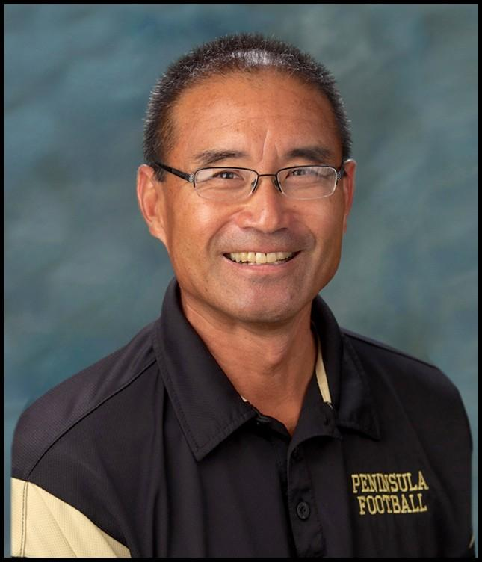
Thank You
Wendell Yoshida
Palos Verdes Peninsula High School
Athletic Director
For more than thirty years, Wendell Yoshida has served this community in many roles as a coach, teacher, and Athletic director. His recent retirement announcement gives us all an opportunity to honor a man that has devoted his life to high school athletics and teaching young adults important life lessons, both on and off the court. No matter what his title, he has always made the student-athlete his priority. He understands the lessons that can be learned on the playing field and has seen his role morph over the years, from a coach to his team’s players to a mentor to all; athletes, coaches, and parents.
As important as athletics is to him, he has always placed academic success and family before the value of a win. He has never missed an opportunity to remind us all that we need to always “put family first.” A great lesson from a humble man that has made it his career to serve others.
Peninsula High will be forever changed by the impact he has had on this school as a whole. I feel fortunate to have had the opportunity to see his success as a coach when I was a student and then work beside him as a colleague for the last few years. He is one of those people that is simply motivated to always do what is right. I thank him deeply for allowing me to be a part of his long and successful career.
Thank you, Wendell, for all you have done for our school and the community. We will miss you dearly but know your impact on this school will be seen and felt for many years to come. Go Panthers!
– Dr. Brent Kuykendall

